Slide 1
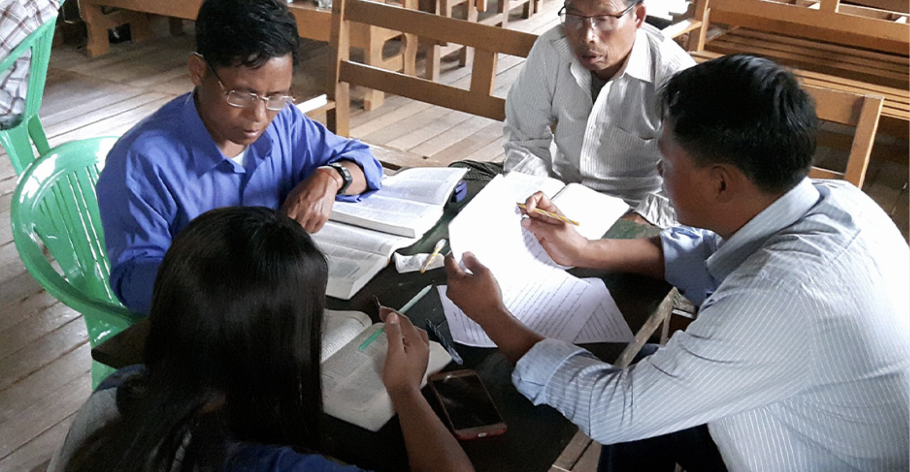
Checking Step 7: Key Words

Slide 2
?
How would you define a key word?

Slide 3
A strong impact on meaning
Abstract words
Spiritual
terms
Often repeated for emphasis

Slide 4
?
What earlier MAST steps might reveal errors?
Why target these words?
Often no precise equivalent
Often hard to translate

Slide 5
For God so loved the world, that he gave his only Son, that whoever believes in him will not perish but have eternal life.
John 3:16 (ULB)

Slide 6
For God so loved the world, that he gave his only Son, that whoever believes in him will not perish but have eternal life.
John 3:16 (ULB)

Slide 7
Try it
Luke 17

Slide 8
Discuss
?
Are the lists the same?
Are some words on everyone’s lists?
Why the differences?

Slide 9
What to do with the key word list
Check translation for each key word.
Discuss difficult words and choose how to translate.
Create list to be used by all translators.

Slide 10


